Slide 1
Chapter 22
Web Hosting and Internet Servers

Slide 2
Web Hosting Basics (1)
Three major techniques in WWW (World Wide Web) System
  HTML
  HTTP
  URL
HTML (1) – HyperText Markup Language
  Providing a means to describe the structure of text-based information in a document.
  The original HTML is created by Tim Berners-Lee.
  Published in 1993 by the IETF as a formal "application" of SGML (with an SGML Document Type Definition defining the grammar).
  The HTML specifications have been maintained by the World Wide Web Consortium (W3C).
    http://www.w3.org/

Slide 3
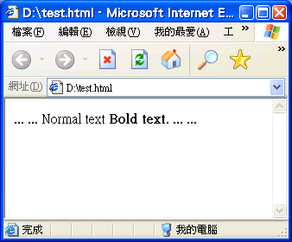
Web Hosting Basics (2)
HTML (2)
  Mark-up the text and define presentation effect by HTML Tags.
<html>
<body>
...
...
Normal text <strong>Bold text</strong>.
...
...
</body>
</html>
Notes:
HTML http://zh.wikipedia.org/w/index.php?title=HTML&variant=zh-tw

Slide 4
Web Hosting Basics (3)
HTTP – Hyper-Text Transfer Protocol
  A TCP-based protocol
  Communication method between client and server, both browsers and web servers have to follow this standard.
  Originally designed to transmit HTML pages.
  Now it is used to format, transmit, and link documents of variety media types
    Text, picture, sound, animation, video, …
  HTTPS – secured version.

Slide 5
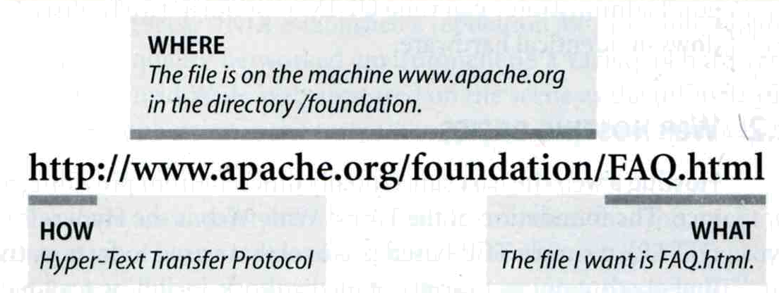
Web Hosting Basics (4)
URL – Uniform Resource Locator
  Describe how to access an object shared on the Internet
  Format
    Protocol :// [ [ username [ :password ] @ ] hostname [ :port ] ] [ /directory ] [ /filename ]
  ex:
    http://www.cs.nctu.edu.tw/
    ftp://ftp.isu.edu.tw/
    telnet://ptt.cc/
Notes:
透過 網路, 藉由不同的通訊協定來存取 Internet 上所分享的東西

Slide 6
Web Hosting Basics (5)
URL Protocols
Proto | What it does | Example
http | Accesses a remote file via HTTP | http://www.csie.nctu.edu.tw
https | Accesses a remote file via HTTP/SSL | https://www.csie.nctu.edu.tw
ftp | Accesses a remote file via FTP | ftp://ftp.csie.nctu.edu.tw/
mailto | Sends mail | mailto:chwong@csie.nctu.edu.tw
news | Accesses Usenet newsgroups | news:tw.bbs.comp.hardware
telnet | Logs in to a remote computer | telnet://bbs.csie.nctu.edu.tw
file | Access a local file | file:///home/chwong/.tcshrc

Slide 7
Web Hosting Basics (6)
Using “telnet” to web server
chbsd [/home/chwong] -chwong- telnet www.cs.nctu.edu.tw 80
Trying 140.113.235.111...
Connected to www.cs.nctu.edu.tw.
Escape character is '^]'.
GET / HTTP/1.0
HTTP/1.0 200 OK
Date: Wed, 27 Dec 2006 00:46:53 GMT
Server: Apache
Last-Modified: Wed, 25 Jan 2006 12:31:34 GMT
ETag: "250404-aa-b5eb580"
Accept-Ranges: bytes
Content-Length: 170
Content-Type: text/html
X-Cache: MISS from cswproxy.cs.nctu.edu.tw
Via: 1.0 cswproxy.cs.nctu.edu.tw:80 (squid/2.6.STABLE3)
Connection: close
<html>
<head>
<title>NCTU -- CS</title>
<META HTTP-EQUIV="Pragma" CONTENT="no-cache">
<meta http-equiv="refresh" content="0; URL=chinese/doc/index.html">
</head>
</html>
Connection closed by foreign host.

Slide 8
Web Hosting Basics (7)
Client-server architecture
  Web Server: Answer HTTP request
  Web Client: Request certain page using URL
1. 以 URL 描述索取的資源位置向 Server 發送要求
3. 從 URL 描述的位置將 HTML 文件取出並回覆給 Client
Client
Browser
Web Server
2. 以 HTTP 協定送出 Request
4. 以 HTTP 協定回覆 Response
5. 接收到 HTML 後由 Browser 解析後根據 HTML 描述定義將資料呈現出來

Slide 9
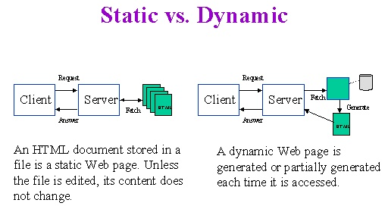
Web Hosting Basics (8)
Static vs. Dynamic Pages

Slide 10
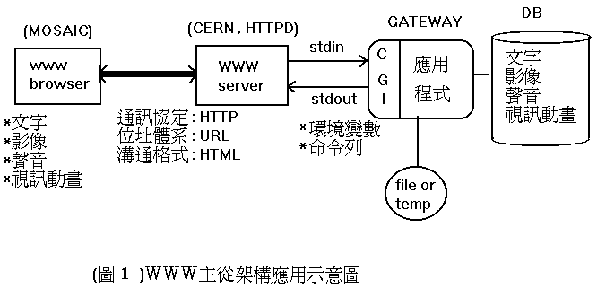
Web Hosting Basics (9)
Common Gateway Interface
  A specification that allows an HTTP server to exchange information with other programs

Slide 11
Virtual Interface

Slide 12
Virtual Interface
Idea
  Let single machine responds to more IP addresses than it has physical network interfaces
  Each of the virtual network interface can be associated with different domain name
Ex:
  One NIC with two IP
sabsd [/home/chwong] -chwong- ifconfig
sk0: flags=8843<UP,BROADCAST,RUNNING,SIMPLEX,MULTICAST> mtu 1500
options=b<RXCSUM,TXCSUM,VLAN_MTU>
inet 140.113.17.215 netmask 0xffffff00 broadcast 140.113.17.255
inet 140.113.17.221 netmask 0xffffffff broadcast 140.113.17.221
ether 00:11:d8:06:1e:81
media: Ethernet autoselect (100baseTX <full-duplex,flag0,flag1>)
status: active
lo0: flags=8049<UP,LOOPBACK,RUNNING,MULTICAST> mtu 16384
inet 127.0.0.1 netmask 0xff000000

Slide 13
Virtual Interface Configuration –
FreeBSD
Using “ifconfig” command and “alias” option
  % ifconfig sk0 inet 140.113.17.221 netmask 255.255.255.255 alias
  % ifconfig sk0 inet 140.113.17.221 delete
  (when you want to delete it)
Specify in /etc/rc.conf
ifconfig_sk0="inet 140.113.17.215 netmask 255.255.255.0"
ifconfig_sk0_alias0="inet 140.113.17.221 netmask 255.255.255.255"
defaultrouter="140.113.17.254"
hostname=“sabsd"
…

Slide 14
Virtual Interface Configuration –
Linux
Using ifconfig command
  % ifconfig eth0:0 140.113.235.6 netmask 255.255.255.0 up
Add file under /etc/sysconfig/network-scripts/
  Original IP: /etc/sysconfig/network-scripts/ifcfg-eth0
  Add /etc/sysconfig/network-scripts/ifcfg-eth0:0
DEVICE=eth0:0
BOOTPROTO=static
BROADCAST=140.113.235.255
IPADDR=140.113.235.6
NETMASK=255.255.255.0
NETWORK=140.113.235.0
ONBOOT=yes

Slide 15
Virtual Interface Configuration –
Solaris
Edit /etc/hostname.interface:1 and /etc/inet/hosts
Ex:
  /etc/hostname.hme0
  Edit /etc/hostname.hme0:1 and /etc/inet/hosts
ccsun3 [/u/dcp/94/9455832] -chwong- cat /etc/hostname.hme0
ccsun3
ccsun3 [/u/dcp/94/9455832] -chwong- cat /etc/hostname.hme0:1
ccsun10
ccsun3 [/u/dcp/94/9455832] -chwong- cat /etc/inet/hosts
127.0.0.1 localhost
140.113.209.103 ccsun3
140.113.209.110 ccsun10
ccsun3 [/u/dcp/94/9455832] -chwong- ifconfig -a
lo0: flags=1000849<UP,LOOPBACK,RUNNING,MULTICAST,IPv4> mtu 8232 index 1
inet 127.0.0.1 netmask ff000000
hme0: flags=1000843<UP,BROADCAST,RUNNING,MULTICAST,IPv4> mtu 1500 index 2
inet 140.113.209.103 netmask ffffff00 broadcast 140.113.209.255
hme0:1: flags=1000843<UP,BROADCAST,RUNNING,MULTICAST,IPv4> mtu 1500 index 2
inet 140.113.209.110 netmask ffffff00 broadcast 140.113.209.255

